Slide 1

Cyclistic Bike Share
Analysis of member vs casual riding patterns
Presented by: Mariana Mytiliños
Last updated: November 22, 2021
Google Data Analytics Professional Certificate Capstone Project

Slide 2
Member vs casual rides

Slide 3
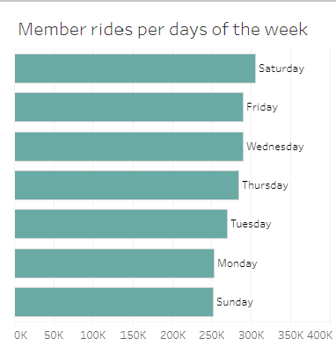
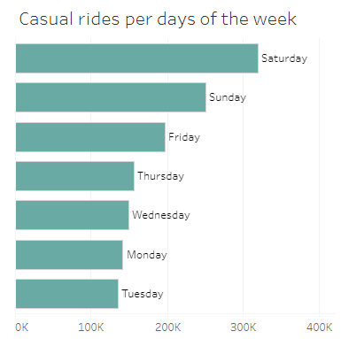
Figure 1: Member and casual rides per day of the week. Source: Tableau Online.

Slide 4
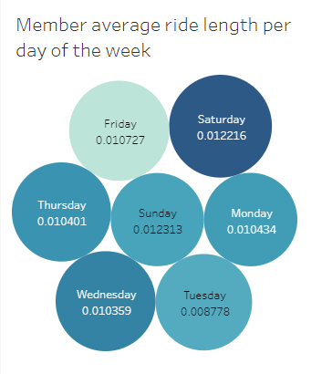
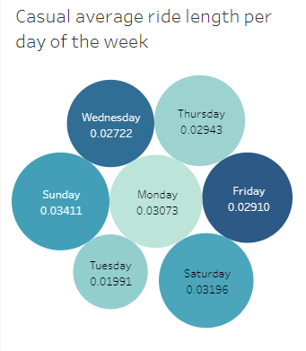
Figure 2: Member and casual average ride length per day of the week. Source: Tableau Online.

Slide 5
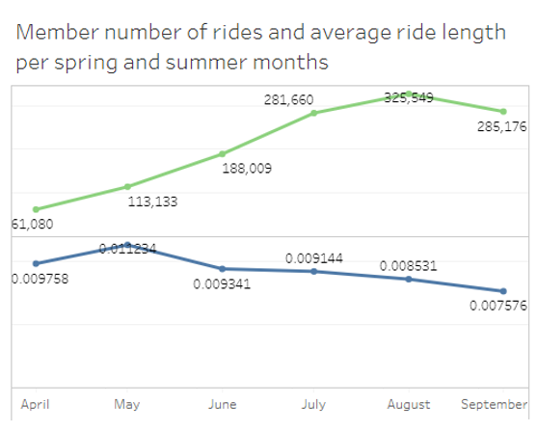
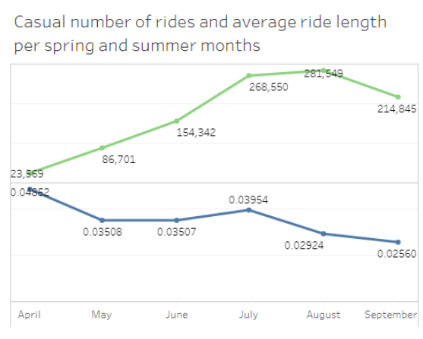
Figure 3: Member and casual number of rides and average ride length per spring and summer months. Source: Tableau Online.

Slide 6
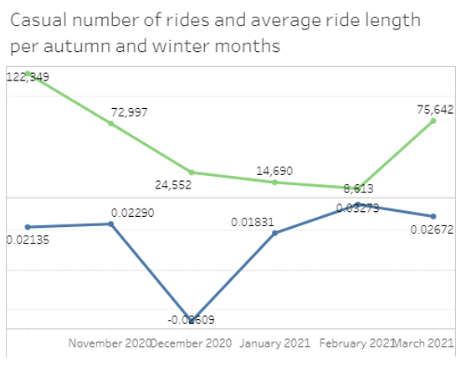
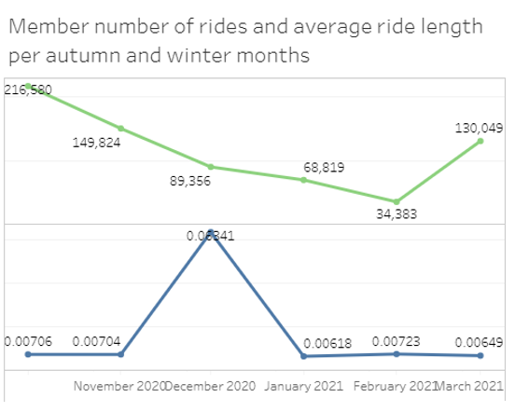
Figure 4: Member and casual number of rides and average ride length per autumn and winter months. Source: Tableau. Online.

Slide 7
Member vs casual bike type selection

Slide 8
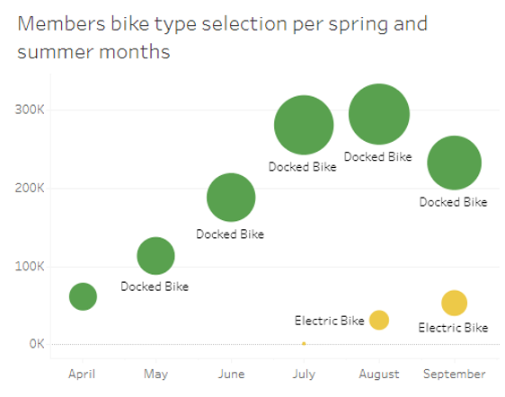
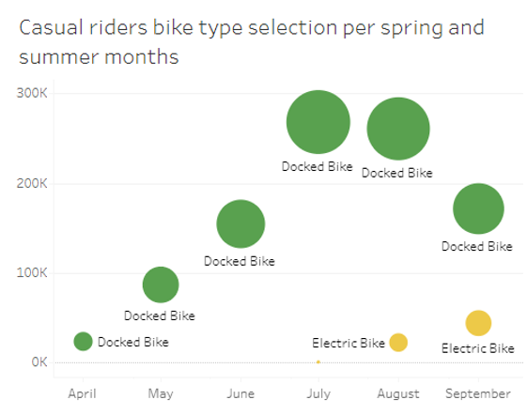
Figure 5: Member and casual bike type selection per spring and summer months. Source: Tableau Online.

Slide 9
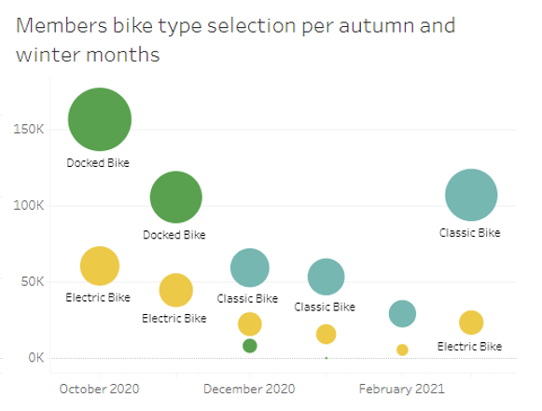
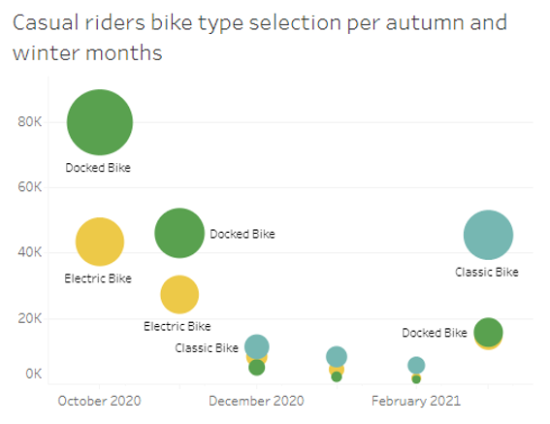
Figure 6: Member and casual bike type selection per autumn and winter months. Source: Tableau Online.

Slide 10
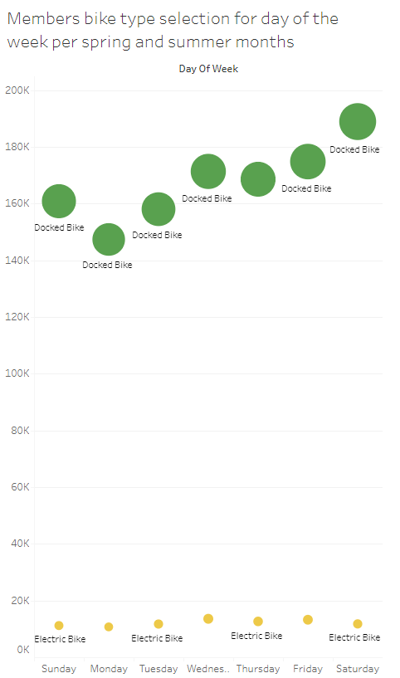
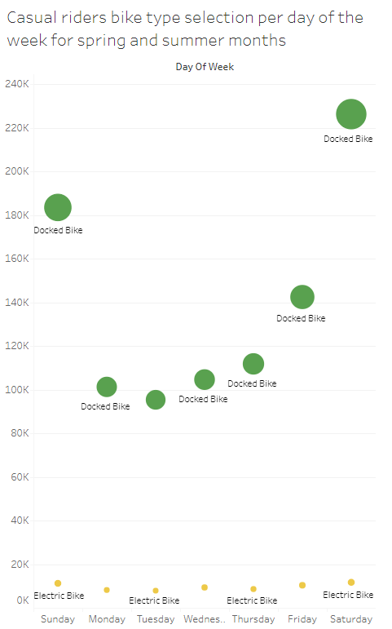
Figure 7: Member and casual bike type selection per day of the week for spring and summer months. Source: Tableau Online.

Slide 11
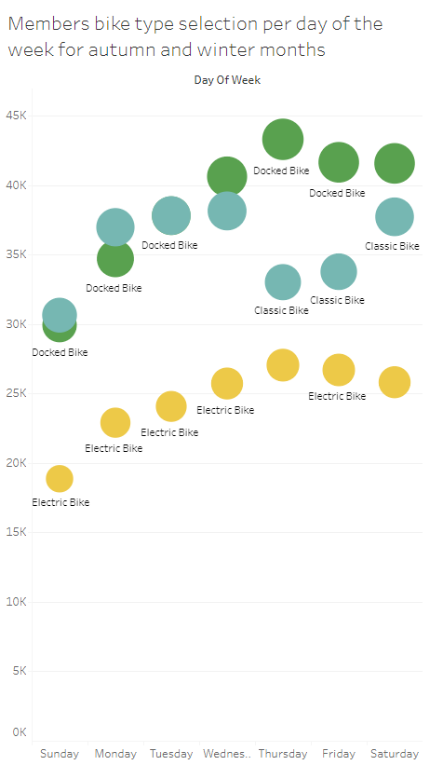
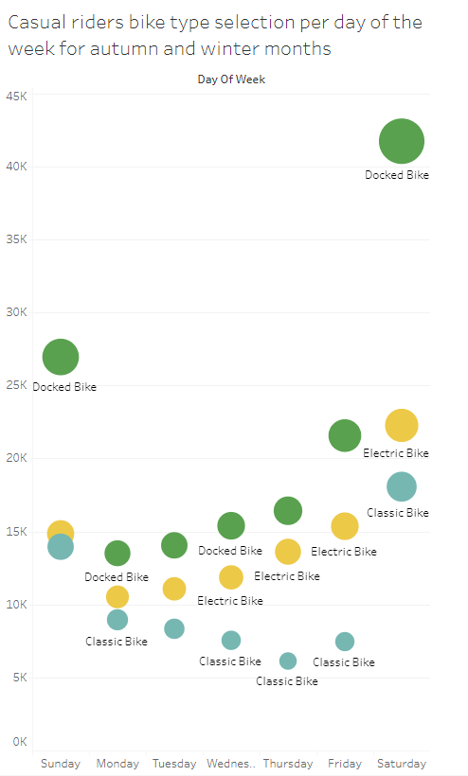
Figure 8: Member and casual bike type selection per day of the week for autumn and winter months. Source: Tableau Online.

Slide 12
Member vs casual rides top start stations

Slide 13
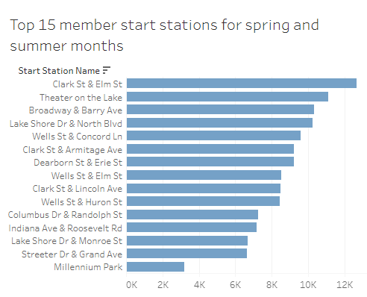
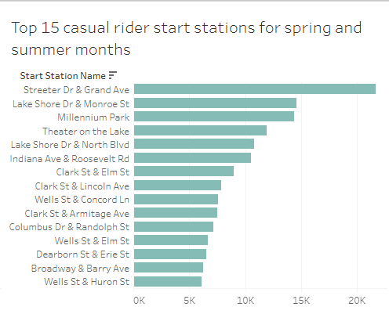
Figure 9: Member and casual top 15 start stations for spring and summer months. Source: Tableau Online.

Slide 14
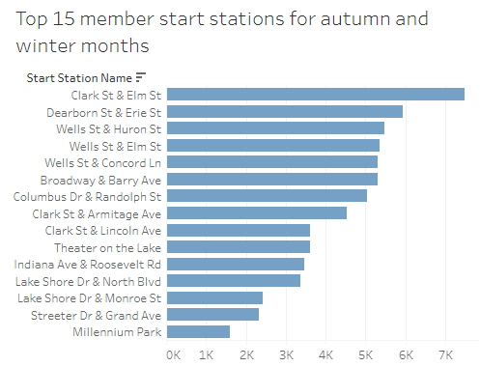
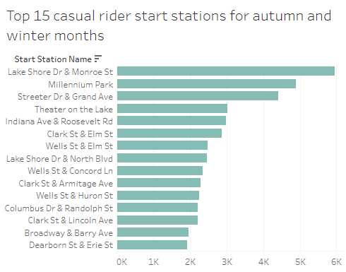
Figure 10: Member and casual top 15 start stations for autumn and winter months. Source: Tableau Online.

Slide 15
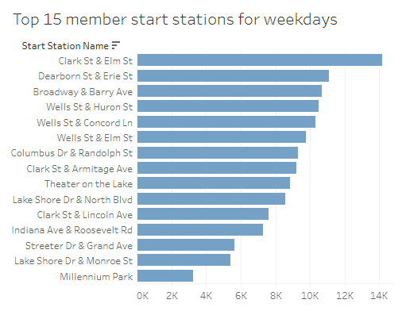
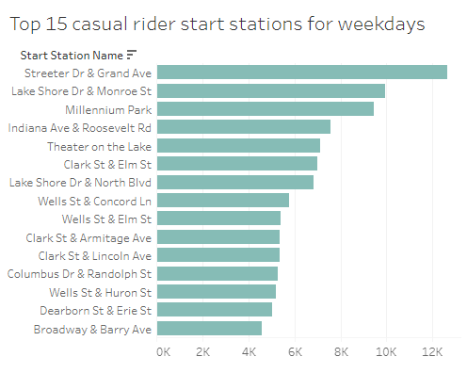
Figure 11: Member and casual top 15 start stations for weekdays. Source: Tableau Online.

Slide 16
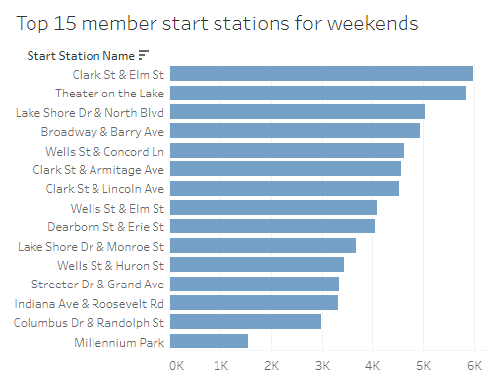
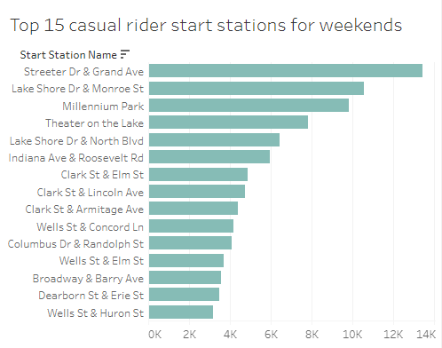
Figure 12: Member and casual top 15 start stations for weekends. Source: Tableau Online.

Slide 17
Thank you

Slide 18
Appendix
Tableau dashboards

Slide 19
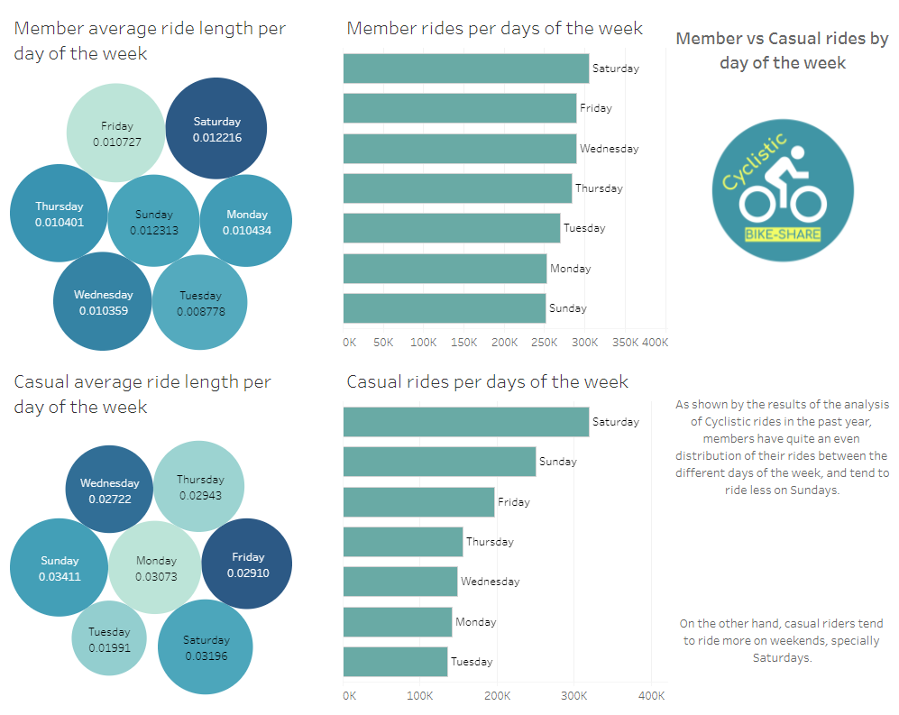

Slide 20
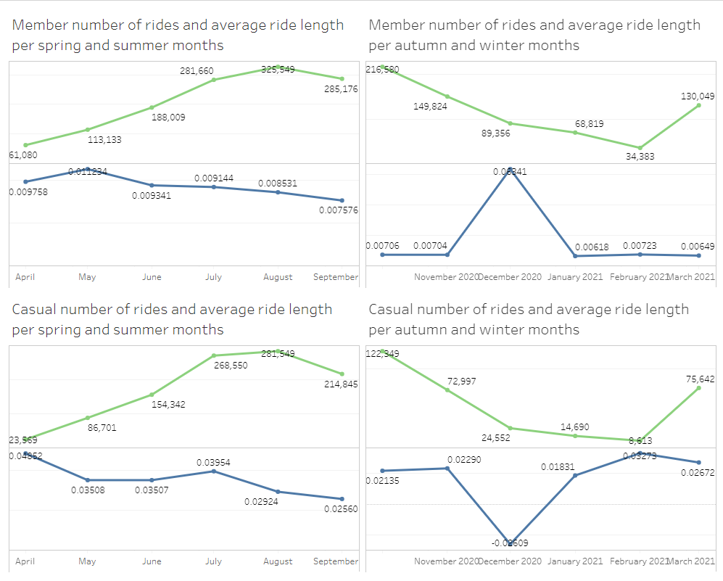

Slide 21
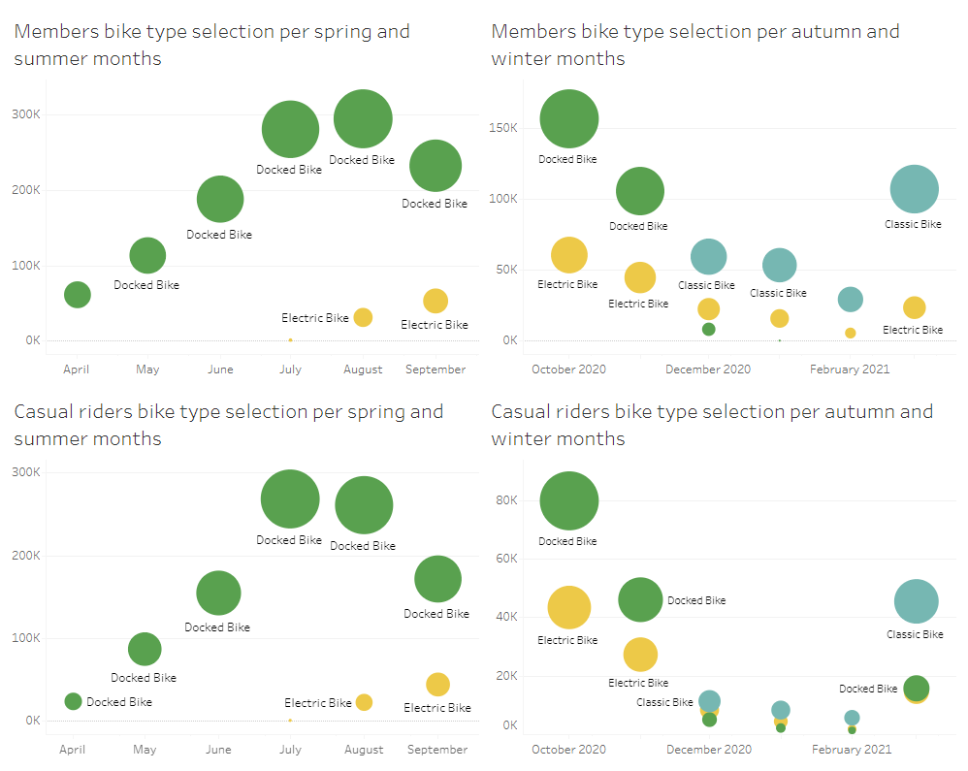

Slide 22
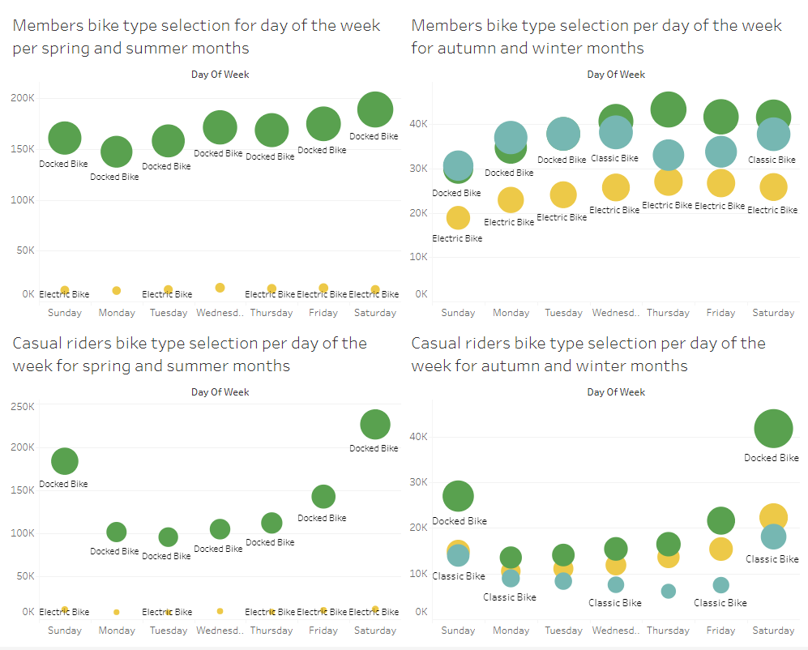

Slide 23
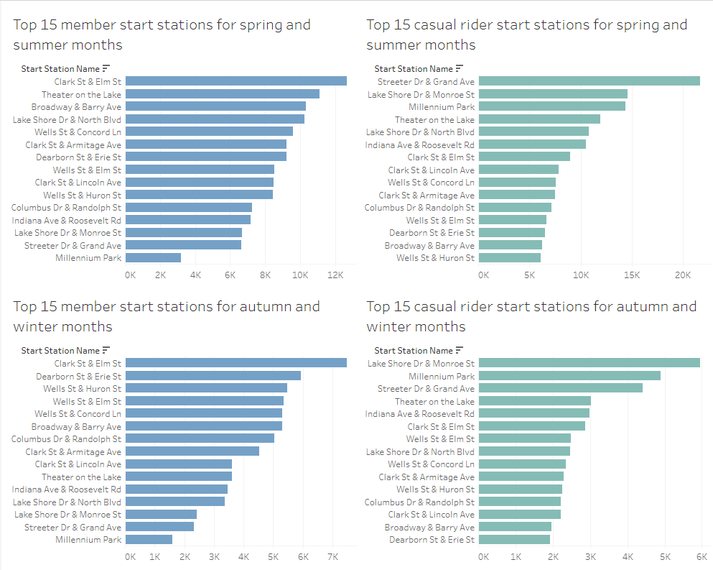

Slide 24
